Slide 1
Final Project Report [Option 1]: Recommended Project
CIS 6261: Trustworthy Machine Learning
Mohammad Uzair Fasih (6282-1020)
Ammar Amjad (5992-1730)
Mohammad Anas (5981-5998)

Slide 2
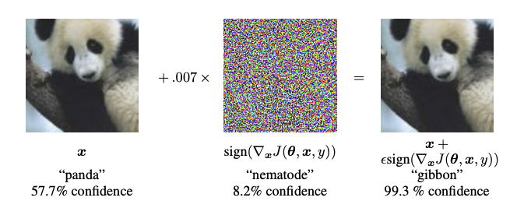
Introduction - Defending Machine Learning Models Against Attacks
Machine learning models face risks from various attacks:
Adversarial attacks (e.g., FGSM, PGD)
Data privacy attacks (e.g., Membership Inference Attacks)
Attacks can compromise:
Accuracy
Fairness
Integrity
Project Objective: Identify and evaluate potential defenses against MIA and Adversarial attacks.
Notes:
As we continue to rely on machine learning models to make critical decisions in various fields, such as healthcare, finance, and security, it is essential to ensure that these models are reliable and trustworthy. Unfortunately, these models are vulnerable to attacks such as Adveserial attacks and data privacy attacks. These attacks can compromise their accuracy, fairness, and integrity.
In light of this, we embarked on a project to identify and evaluate potential defenses against different types of attacks.

Slide 3
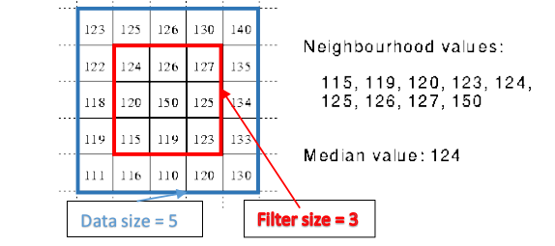
Defense Categories
1- Input Data Filtering or Denoising Techniques
Remove perturbations from input data
Reduce effectiveness of adversarial perturbations
2- Runtime Adversarial Training
Improve model's robustness
No need to retrain from scratch
3- Certified Robustness Approaches (e.g., Randomized Smoothing)
Provable guarantees of model robustness
Focus on Randomized Smoothing
Note: Limited to these categories due to time constraints and trade-offs
Notes:
The first category is Input Data Filtering or Denoising Techniques. This approach aims to remove perturbations from input data and reduce the effectiveness of adversarial perturbations. By using this defense, we can improve the accuracy and robustness of the model against adversarial attacks.
The second category is Runtime Adversarial Training. This approach involves improving the model's robustness without the need to retrain it from scratch. This can save a significant amount of time and resources while still improving the model's ability to withstand adversarial attacks.
The third category is Certified Robustness Approaches, specifically Randomized Smoothing. This approach provides provable guarantees of model robustness against adversarial examples. By using Randomized Smoothing, we can reduce the risk of model failure due to adversarial attacks.

Slide 4
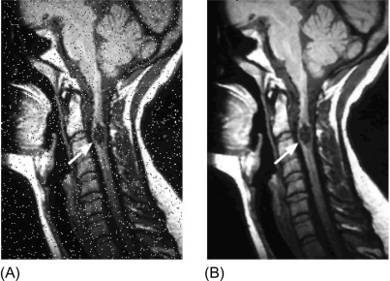

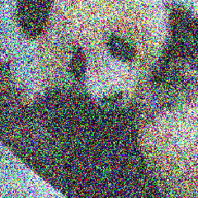
Defense Categories
Input data filtering or Denoising techniques
Gaussian Smoothing
JPEG Compression
Median Filtering
Runtime Adversarial training
Crafting adversarial examples using FGSM at runtime and training the model
Certified Robustness
Randomized Smoothing
Median Filter with a 3 × 3 kernel (source: sciencedirect)
Certified Adversarial Robustness via Randomized Smoothing (source: GitHub:locuslab/smoothing)
Notes:
In input data filtering, we did gaussian filtering smoothing JPEG compression and median filtering. In run time adversarial training, we crafted adversarial examples using FGSM and trained the model. Finally in certified robustness, we used randomized smoothing algorithm. My collage, Ammar will elaborate on it.

Slide 5
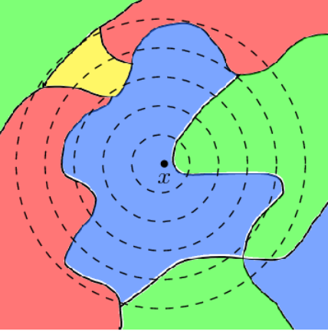
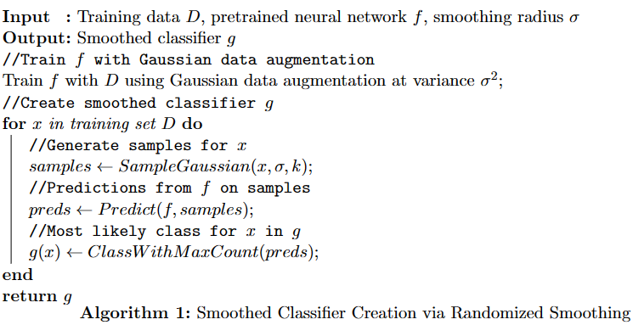
Approaches & Technique
Certified Robustness
Notes:
Hi my names is Ammar Amjad, the following slides cover the different appraoches we explored.
Firstly, Certified Robustness is a defense approach against adversarial attacks that offers provable guarantees and broad applicability. We implement this defense method by creating a smoothed classifier (g) using training data (D), a pretrained neural network (f), and a smoothing radius (σ). We train the network (f) with Gaussian data augmentation and create the smoothed classifier (g) by iterating over the training set. For each data point, we generate Gaussian samples, make predictions with (f), and determine the most likely class based on the maximum count. The resulting smoothed classifier (g), created using Randomized Smoothing, provides a robust defense against adversarial attacks with certified guarantees.

Slide 6
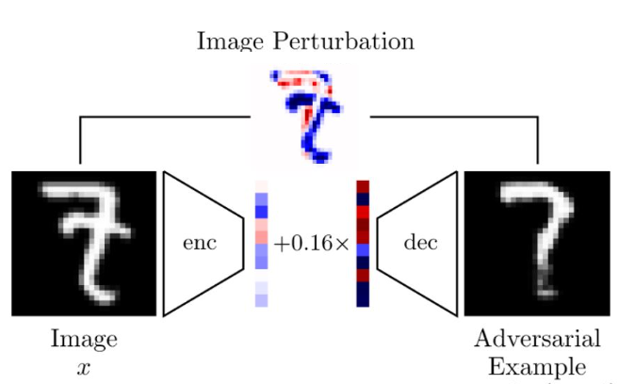
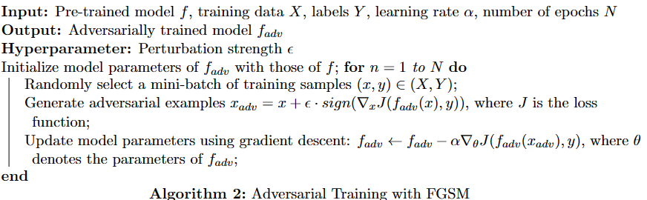
Approaches & Technique
Adversarial Training
Notes:
We also implemented Adversarial Training with FGSM to improve model robustness against adversarial attacks while preserving clean data accuracy.
The algorithm takes a pre-trained model, training data, labels, learning rate, and epochs, and outputs an adversarially trained model. Key components include the perturbation strength ε and initializing fadv with pre-trained model parameters.
During training, for each epoch, we:
Select a mini-batch of samples
Generate adversarial examples using FGSM
Update model parameters via gradient descent
To evaluate, we assess accuracy and robustness against adversarial examples, tuning epsilon for an optimal balance between robustness and clean data accuracy.

Slide 7
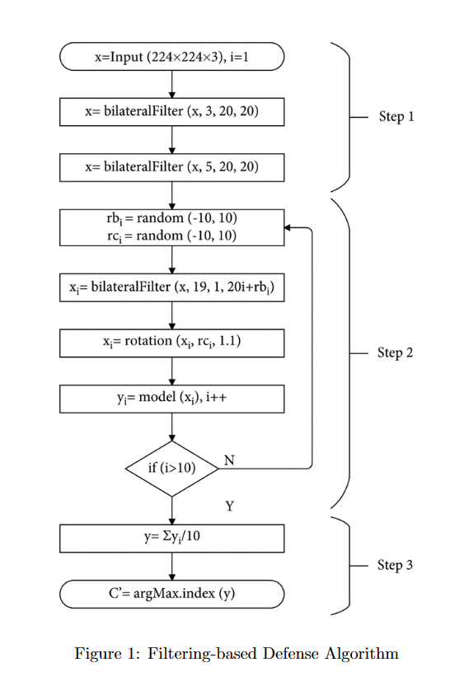
Approaches & Technique
Input data filtering and Denoising techniques
Feng et. al.’s defense:
Bilateral filtering
Rotation
Averaging
Shokri et al.’s defense:
Restrict the prediction vector to the top 3 classes.
Applying Rounding d = 3.
Applying Temperature t = 5.
Liu et. al’s and other’s defenses:
Total Varaition Minimization (TVM)
JPEG Compression
Image Rotation
3 Bit Depth Reduction
Non-local Mean(11-3-4)
Notes:
We applied different input data filtering and denoising techniques in mitigating adversarial and membership inference attacks.
We tested the pre-trained model in conjunction with a custom predict function based on several promising techniques from the literature.
One such paper by Feng et al. proposed a defense method using different filter parameters and randomly rotated filtered images as shown in the image.
Another approach we evaluated was Shokri et al.'s defenses, which included restricting the prediction vector to the top k classes, applying rounding, and adjusting the temperature.
Additionally, we explored other filtering techniques inspired by Liu et al.'s paper and other author’s works, such as Total Variation Minimization (TVM), JPEG Compression, Image Rotation, 3-Bit Depth Reduction, and Non-local Mean filters.
An exhaustive list of the defenses we implemented can be found in Table 3 of our report.

Slide 8
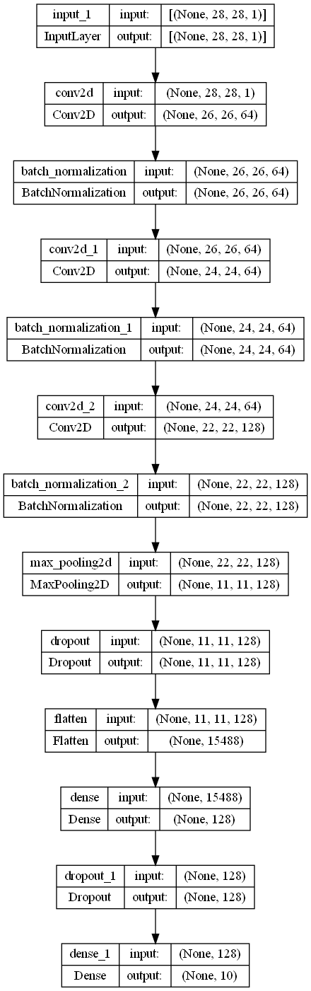
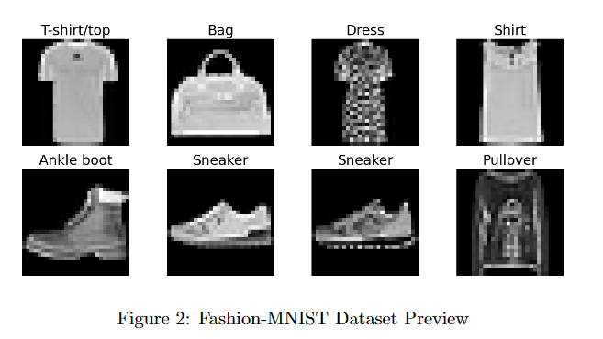
Dataset and Model for Part 2
Fashion-MNIST dataset and CNN
Notes:
In Part 2 of our project, we will be focusing on the Fashion-MNIST dataset. This dataset consists of 60,000 training images and 10,000 test images of grayscale fashion items, each with a size of 28x28 pixels. The dataset includes 10 different fashion categories, making it a perfect drop-in replacement for the original MNIST dataset.
To classify images from the Fashion-MNIST dataset, we implemented a convolutional neural network (CNN) model. Our architecture includes multiple Conv2D, BatchNormalization, MaxPooling2D, Dropout, Flatten, and Dense layers. This design aims to achieve high classification accuracy while mitigating overfitting and improving generalization.
In implementing our defense strategy, we will leverage the insights gleaned from the first part of our project.

Slide 9
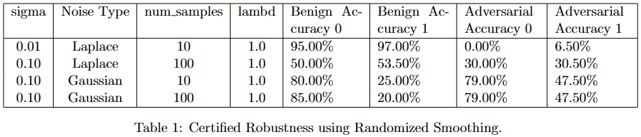
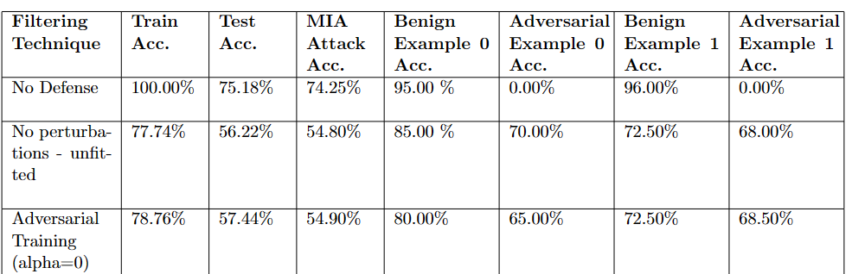
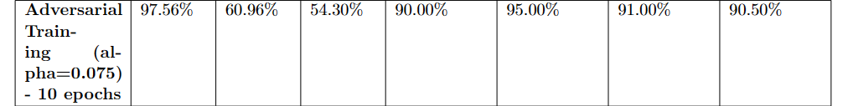
Results
Part 1

Slide 10
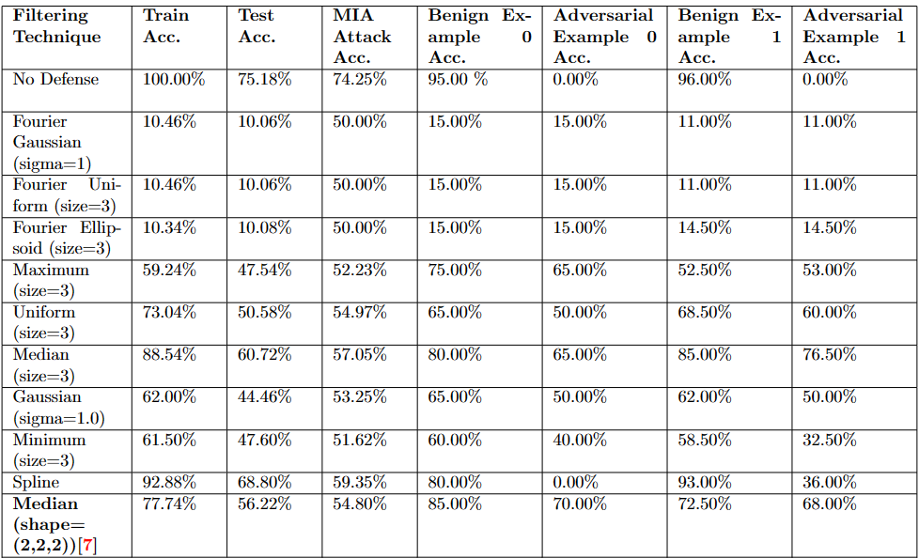

Slide 11
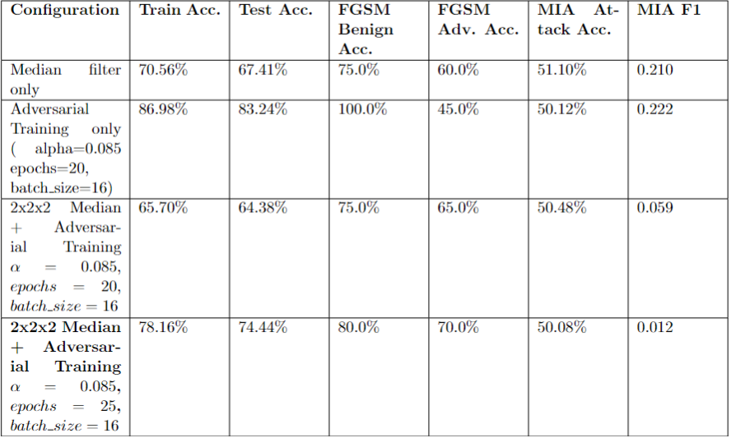
Results - Part 2

Slide 12
Conclusions
Effectiveness of filtering techniques and adversarial training methods varies significantly
Optimal defenses for given dataset:
Adversarial training with FGSM
Median filtering
Certified robustness not viable due to time constraints
Robust Defense Strategy
CNN model and Fashion-MNIST dataset
Most optimal defense: 2x2x2 Median filter + Adversarial Training (α=0.085, epochs=25, batch size=16)
Defense may not be generalizable
No single technique or approach is universally effective
Choice of defense method should be based on problem, balance between performance and robustness, and nature of adversarial attacks
Potential for combining multiple defense techniques

Slide 13
Future Work
Comprehensive analysis of ensemble models and certified robustness techniques
Investigate tabular and text-based datasets
Holistic perspective on defense strategies across various domains

